Slide 1
Project Group 23
Sankeerth Alookaran Jivan
Finley Sullivan
Haosong (Stu) Zhang
Zhi Cong Leon (Leon) Zhou

Slide 2
Research
Inspiration and Similar Websites

Slide 3
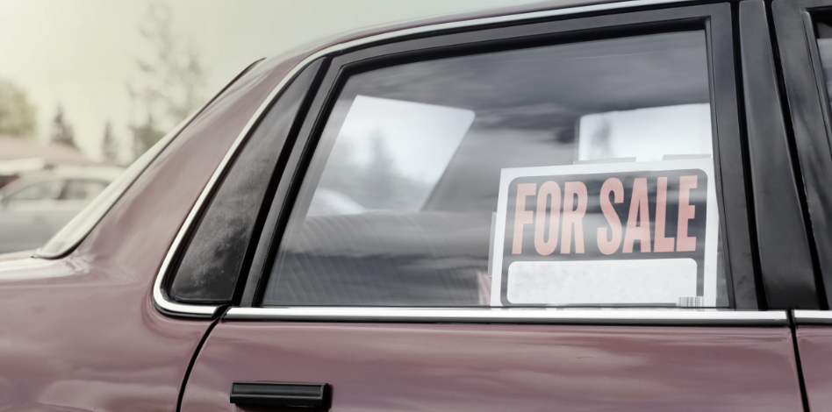
Used Car Sales
As a group we decided on a website for the sale of used cars.
For inspiration, we found the following sites:
https://www.trademe.co.nz/a/motors
https://www.turners.co.nz/Cars/
https://www.2cheapcars.co.nz/
https://www.needacar.co.nz/

Slide 4
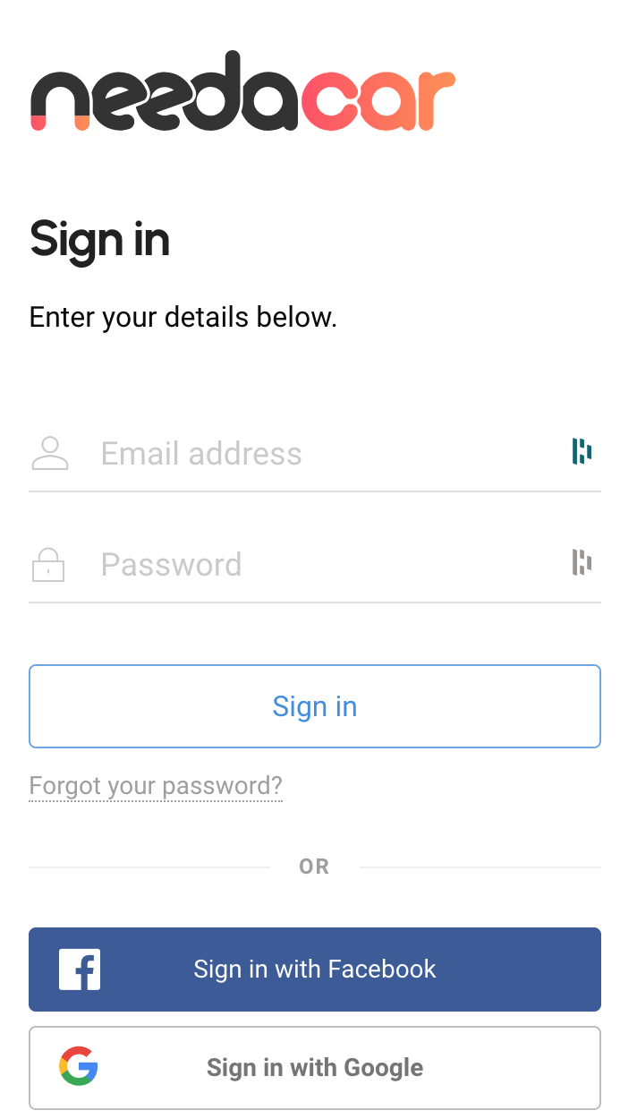
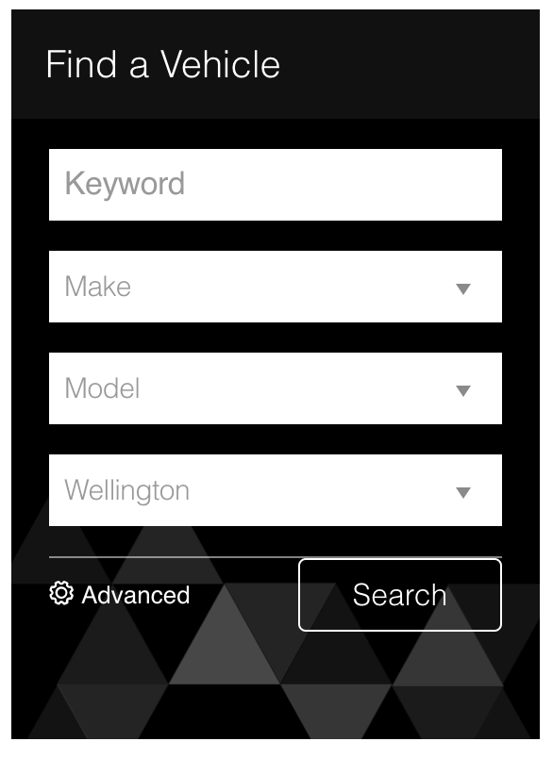
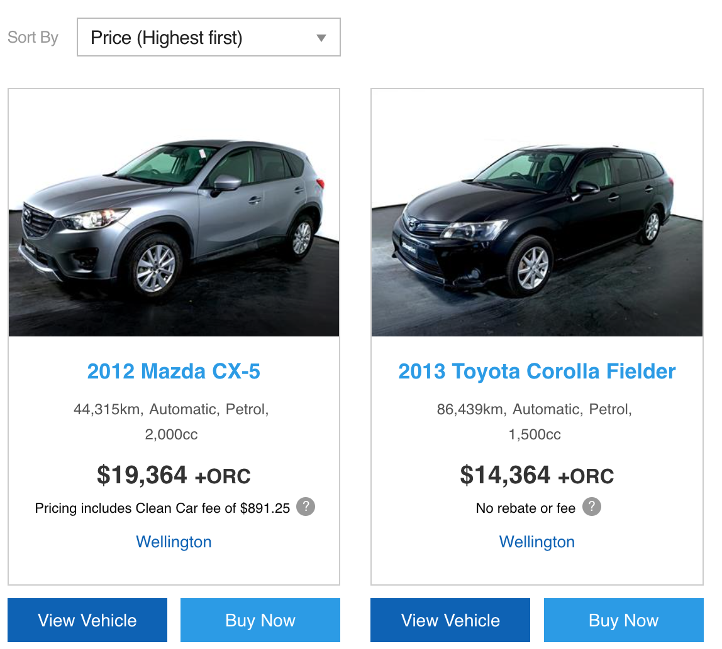
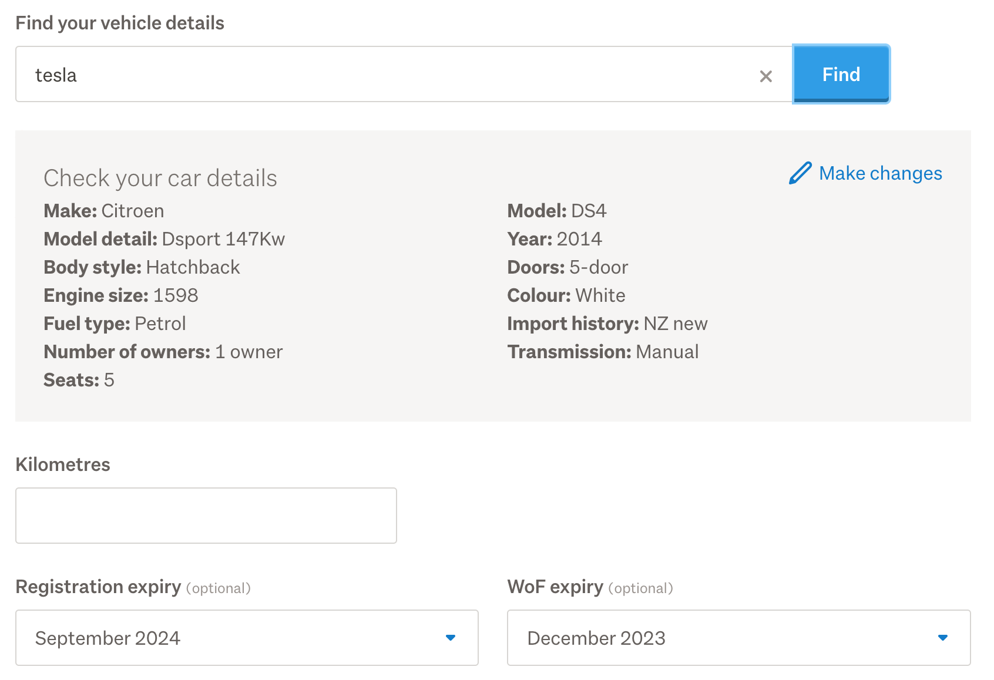
What Does the site need?
Browsing Option
Listing Used Cars
Login Function
Search Function

Slide 5
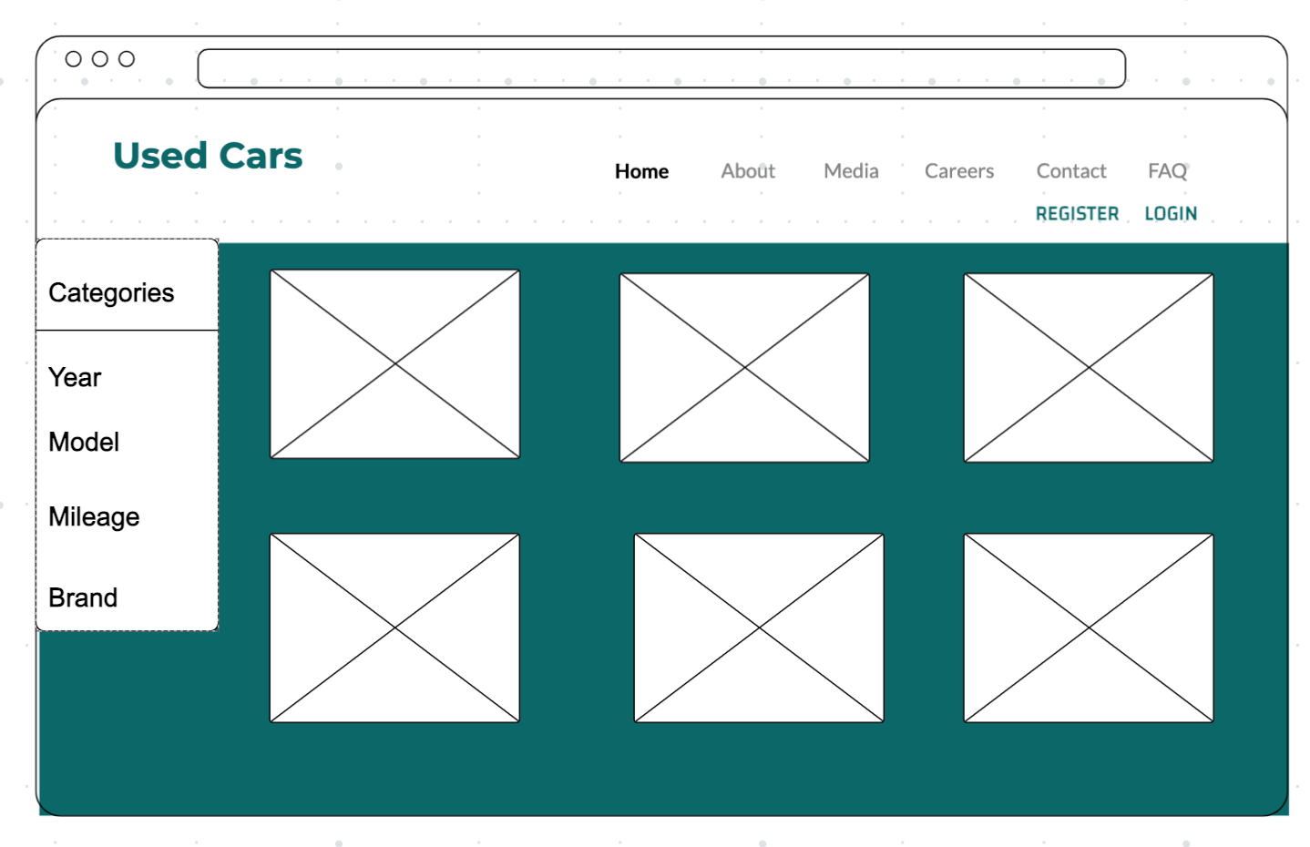
Simple Wireframe

Slide 6
Our Workload

Slide 7
Group Work Division
Finley:
Sankeerth
Stu
Leon
External API connection (microservices)
Firebase Hosting
Server side rendering, web templates
Privacy
User Model (MongoDB)
Register, Login, Logout Function
Use session and JWT for user authentication
Performance testing
Client side rendering

Slide 8
Current Progress Demonstration
https://gitlab.ecs.vuw.ac.nz/nwen304_group/trade-cars

